Slide 1
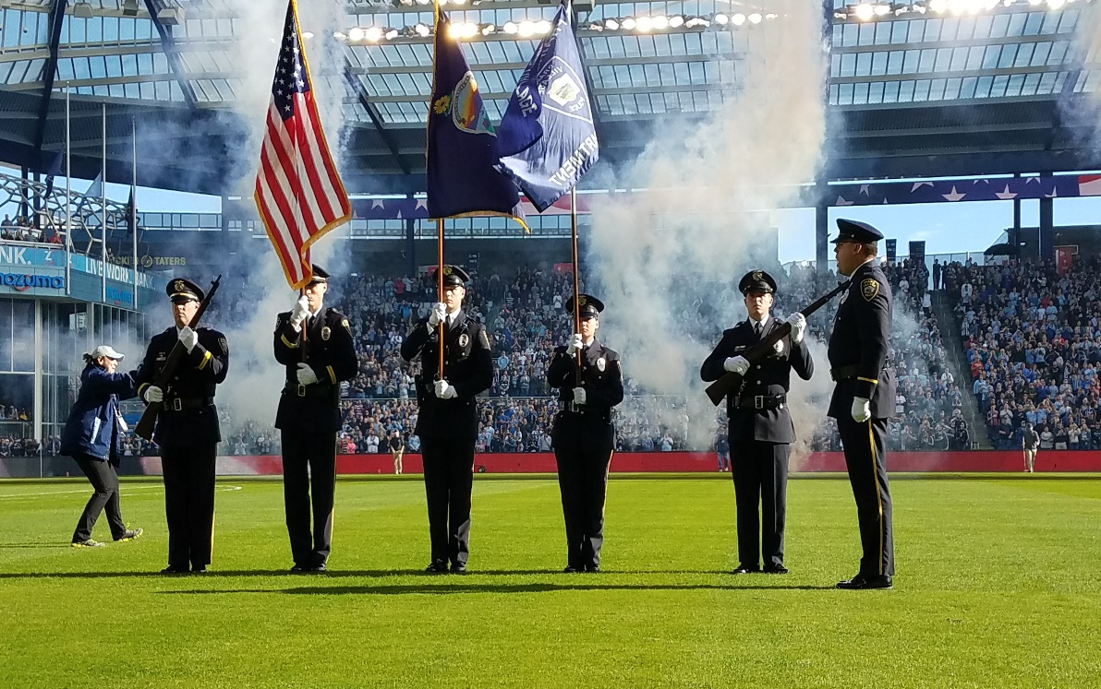

Mission Hills Police Department
Dedication | Integrity | Professionalism | Service

Slide 2

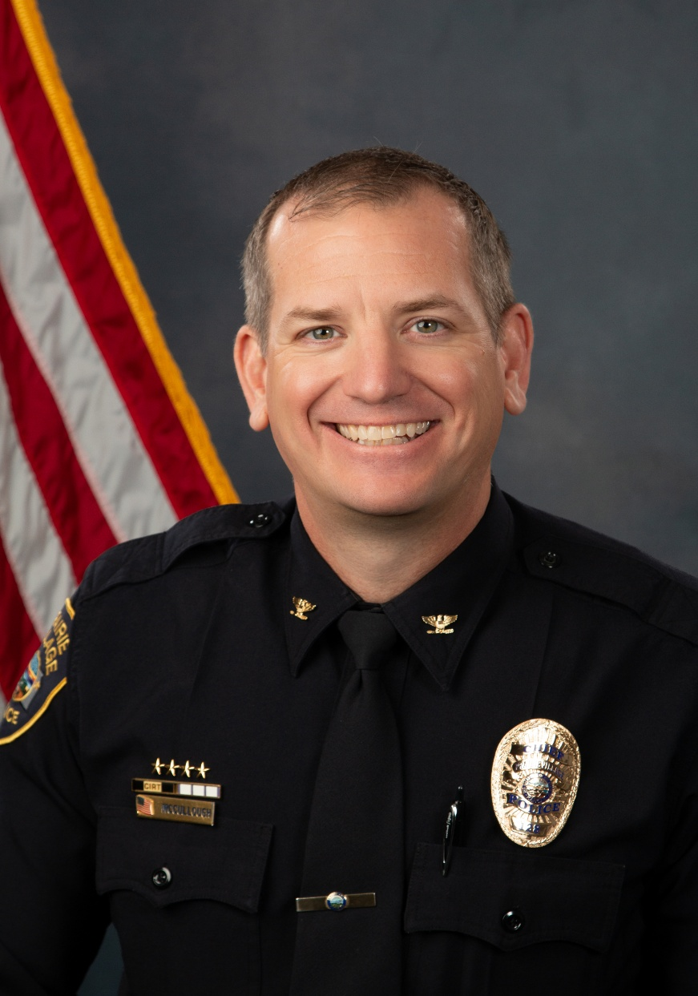
Chief of Police
The Police Department is comprised of 47 sworn officers and 13 non-sworn employees who provide 24-hour law enforcement services for the communities of Prairie Village and the City of Mission Hills.

Slide 3
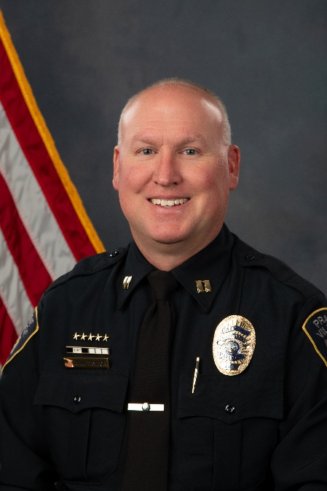
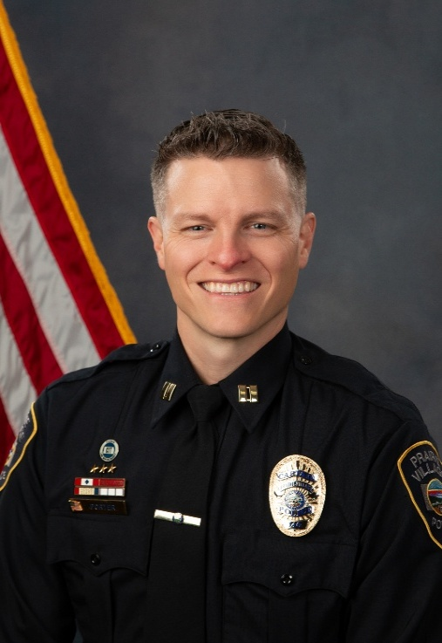
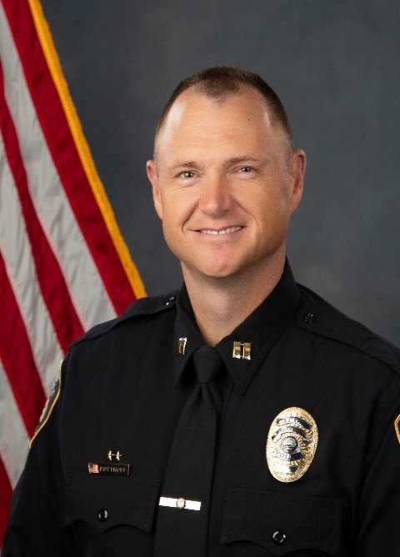
Division Commanders
Investigations Division
Patrol Division
Staff Services Division

Slide 4
Partners in Crime Prevention
Residents
Mayor and Council
Mission Hills Administration / Staff
Police Department
Crime Prevention and Safety Committee

Slide 5
2025 Crime Highlights
Year | 2022 | 2023 | 2024 | 2025
Burglaries | 15 | 13 | 7 | 4
* 3 of the 4 residential burglaries were unlocked or insecure.
Year | 2022 | 2023 | 2024 | 2025
Auto Burgs | 42 | 24 | 24 | 7
* 6 of the 7 auto burglaries were unlocked.
Year | 2022 | 2023 | 2024 | 2025
Auto Theft | 21 | 7 | 21 | 2
* 2 of the 2 auto thefts were unlocked.

Slide 6
Violent Crime
Mission Hills had 1 Non-Domestic Violent Crime in 2025.
With over 1,327 homes in Mission Hills, this is truly remarkable regarding community safety!

Slide 7

Crime Prevention and Safety
Team Effort: We Need Your Help!
  - “If you see something, say something”
  Remove valuables from cars, LOCK, take keys
  - Close/LOCK garage doors, and windows
  House watch program
  Lighting around entrances and driveways
  Alarm systems, camera systems
  Trimming and cleaning up the landscape
Crime Prevention Det. Folvarcik
913-385-4657
Community Connect
(register your cameras)

Slide 8
Don’t Be a Victim!
Commons Scams
SCAM Method | Response
Telephone (late payments, “Government”, IRS, gift cards, threats to arrest) | hang up, block phone number, call police, NEVER give info over phone
Computer (disguised emails from stores, Pop Ups, Advertisements) | don’t click, don’t reply, ask someone else, NEVER send money
Mail (refund & payment checks) | don’t cash or send $ back, shred personal docs, monitor financial accounts
Out & About | Keep purse/wallet close, don’t carry lots of cash, be aware of surroundings
Protect your personal information. Call the police if scammed or have questions.

Slide 9
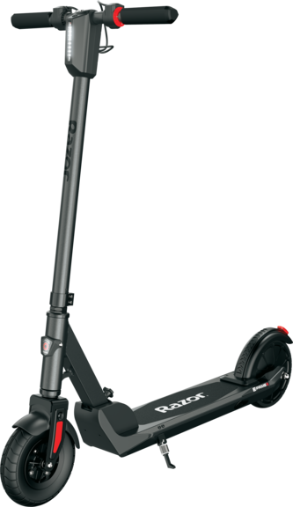
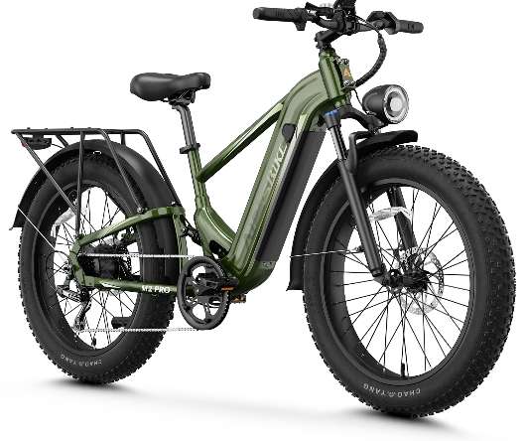
E-Bikes & Scooters
• City Ordinance Updated
• Social Media, website posts
• Worked with SMSD Schools
• Hosted e-bike/scooter check in at PD
• Hosted educational workshop at IHCC
Country Club
• Active police enforcement and response

Slide 10
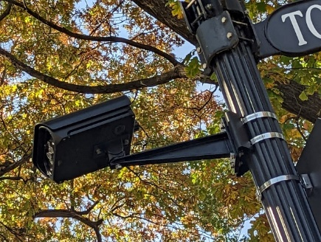


Technology Resources
LPRs at 24 intersections (adding 3 more in 2026)
Cameras at 25 intersections (adding 3 more in 2026)
These are valuable assets in reducing criminal activity in Mission Hills.
Drone First Responder
Grappler Police Bumper

Slide 11

World Cup
• Continual communication with FIFA
2026 KC and other agencies to
determine our role.
• Prepping for equipment and staff
resources that will be needed.
• All hands-on deck for WC (June, July)
• More info to come…

Slide 12
THE YEAR AHEAD
Let us all make a concerted effort to reduce crime; lock your doors, remove valuables from plain sight, remove your car keys, and don’t fall for scams!
From all of us here at the Police Department, thank you for your continued support!

Slide 13
Mission Hills Police Department
Dedication | Integrity | Professionalism | Service

