Slide 1

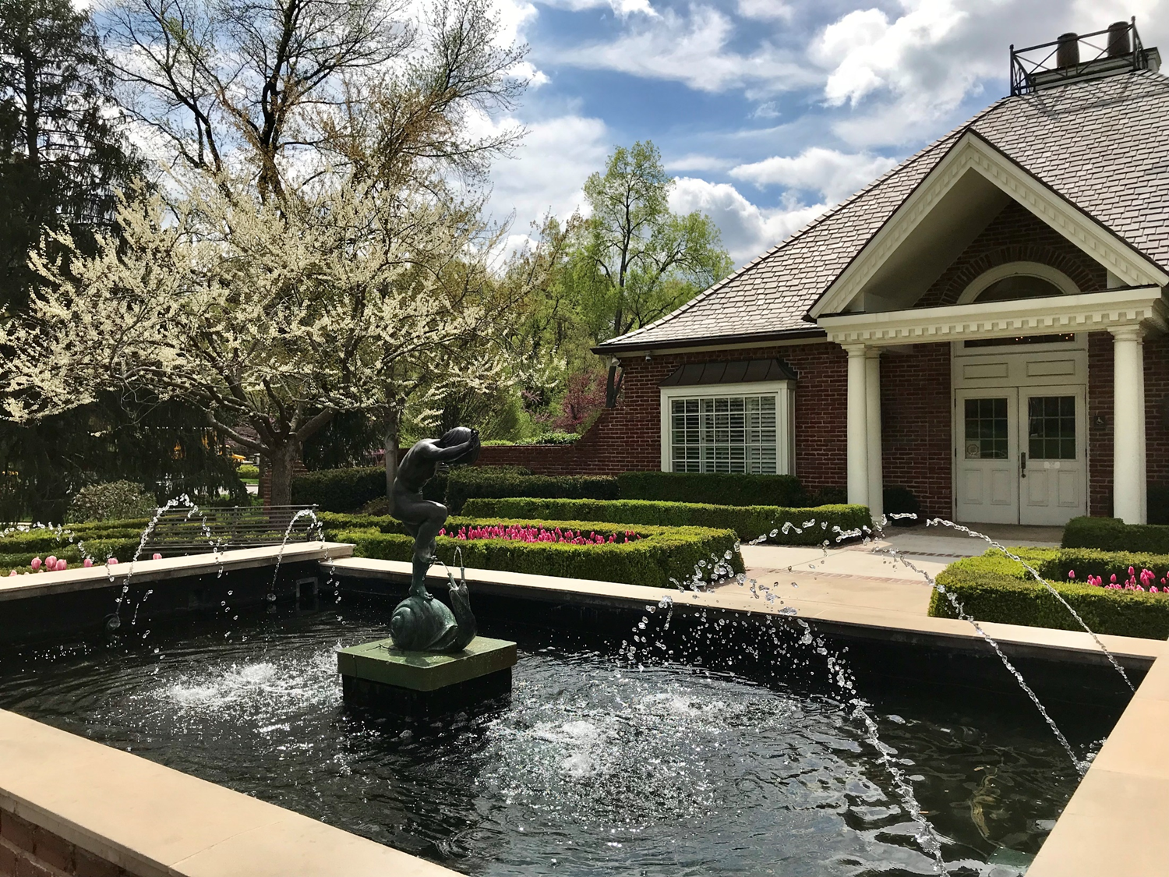
State of the City January 21, 2026

Slide 2
Welcome
Boards and Commissions
Financial Health
Public Safety
Belinder Road & Stormwater Update
6400 State Line Road
World Cup 2026

Slide 3
Staff
City Staff
  Jennifer Lee, City Administrator
  Meghan Woolbright, Assistant City Administrator
  Jill Clifton, City Planner
  Jason Nickles, City Clerk
  Judy Fang, Senior Finance Analyst
  Cole Carmack, City Arborist and Park Coordinator
  Bryce Morgan, Planner
  Steve Crull, Chief Building Inspector
  Eddie Reuscher, Building Inspector
  Renee Mendez, Maintenance
Municipal Court
  Lauren Allen, Judge
  Kathryn Marsh, City Prosecutor

Slide 4

City Council
City Council
  Bill Bruning, Council President
  Eden Thorne
  Gregg Davidson
  Caroline Moran
  Dan Sullivan
  Nick Holmes, City Treasurer

Slide 5
Planning Commission
Tom Roszak, Chair
John Coe, Vice Chair
Chris Anderson
Nick Dosanjh
Tim McQuaid
Stacey Winfield
Sara Greenwood
Nancy Ruzicka
Wyatt Cobb
Alternates:
  Leslie Mark
Meetings: 2nd Wednesday of the month at 5:00 pm

Slide 6

Architectural Review Board
Stacey Winfield, Chair
David Gibson, Vice Chair
David Banks
Nick Dosanjh
Kylie Brewer
Alternates:
  Carrie Craig
  Susan Creidenberg
  Natalie Busch
Meetings: Every other Tuesday at 3pm

Slide 7
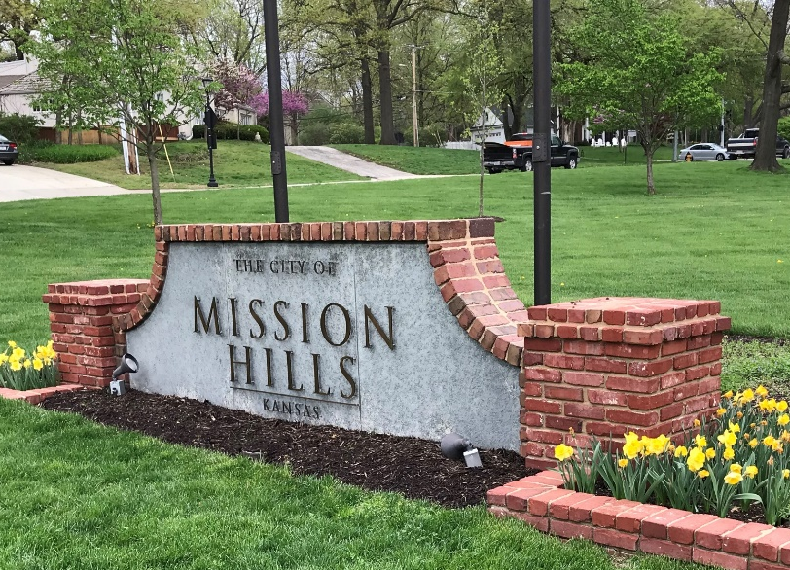
Board of Zoning Appeals
Mark Eisemann, Chair
Gabe Beam, Vice Chair
Casey Halsey
Kent Barnow
Mike Stradinger
Alternates:
  Mary Janes Barnes
  Vacant
  Vacant
Meetings: Last Wednesday of the month at 9am

Slide 8

Crime Prevention and Safety Committee
Tim McQuaid, Chair
Neil Atha
Wyatt Cobb
Kevin Latz
Joseph Reuben
Mike Sinatra
Debbie Ward
Russ Weltner

Slide 9
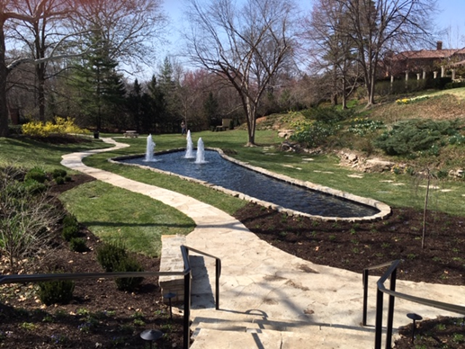
Park Board
Lorelei Gibson, Chair
Mary Ann Powell
Sally Ott
Mary Knighton
Leslie Brett
Britton Norden
Carrie Wagstaff
Sharon Orr
Laura Sutherland
Louise Allen
Lynn Devins
Terri McGhie
Meetings: 1st Tuesday of the month (March-Oct) at 12pm

Slide 10
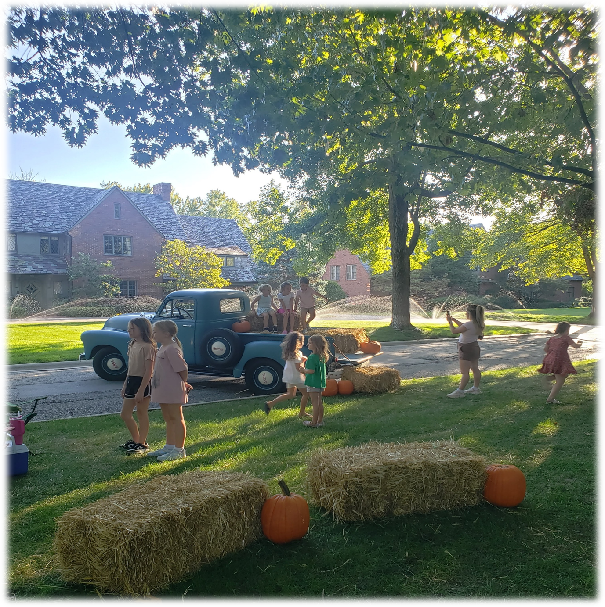
Community Engagement Committee
Caroline Moran and Oliva Lynn, Chairs
Eden Thorne and Gregg Davidson, Council Liaisons
Look for a postcard this spring for the 2026 schedule of events!

Slide 11
Financial Health
Excellent financial position AAA Bond rating
Property values in Mission Hills up 7.14% in 2025
2026 Mill Levy
  21.960 General Fund (unchanged)
  0.806 Debt Service

Slide 12
2026 Budget
Revenues: $10.24M

Slide 13
2026 Budget Expenditures: $10.21M

Slide 14
Public Safety
The trend line for crime in Mission Hills is noticeably down. Three primary factors have improved the City’s crime statistics:
Technology – smart investments in advanced technology including license plate readers (LPR), cameras, grapplers, and soon drone technology will be added
Citizen Awareness – We all have taken more action to reduce the crimes of opportunity. And the 9PM Routine works, thank you!
Staffing – Police Department is close to being fully staffed

Slide 15


Public Safety
License Plate Readers
Current: Network of 24 intersections (31 cameras, 78 LPRs)
Network has led to numerous success stories
Future: 3 additional locations for LPRs/Cameras in the City
Nearly all entrance/exits into the City will be covered

Slide 16
Belinder Road & Stormwater Update
  $3 million investment for street, stormwater, and sidewalks replacement
January to April
Utility Upgrades
Kansas Gas
April to November
City Project
Street
WaterOne
Telecomm/Cable
Stormwater
Sidewalks

Slide 17
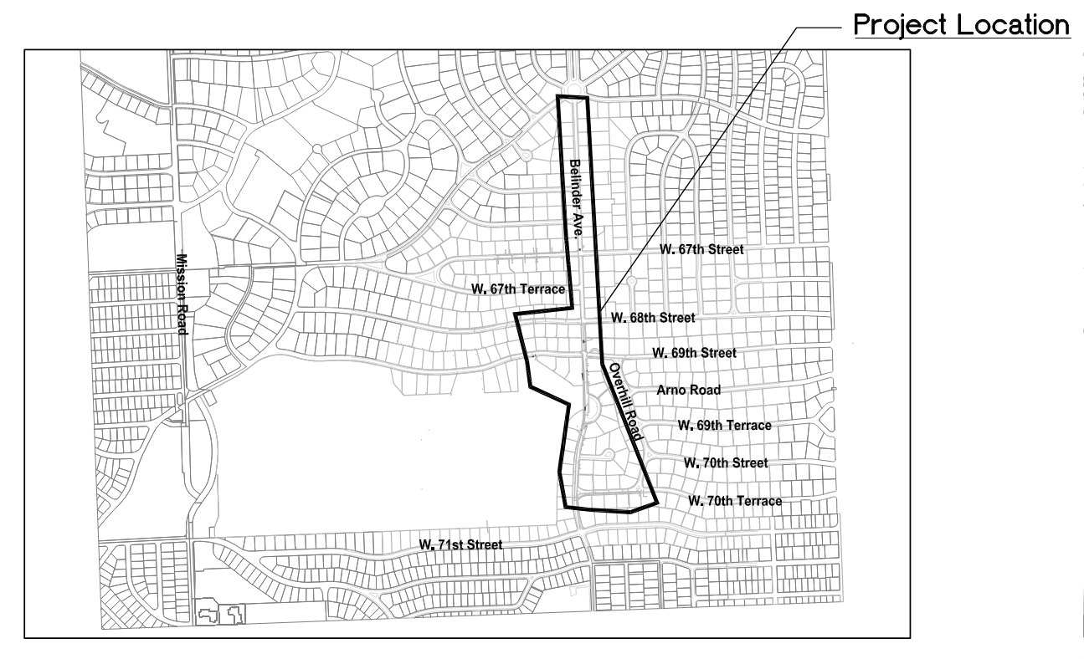
Belinder Road & Stormwater Update

Slide 18
Belinder Road & Stormwater Update
  Belinder Ave – Belinder Circle to 71st St
  70th Ter – Belinder Ave to Overhill Rd
  Gas, Water, and Telecommunication/Cable utilities to be upgraded
  City and Utilities will work together to complete $3 million project including stormwater updates – 1st time in 25 years

Slide 19
Belinder Road & Stormwater Update
  Significant disruption to drivers and Belinder School related traffic– detours to State Line Road and/or Mission Road
  Trying to schedule the most work during the summer
  A City-wide postcard with project details will be mailed to residents soon
  Sign up for regular updates on the City’s website!

Slide 20
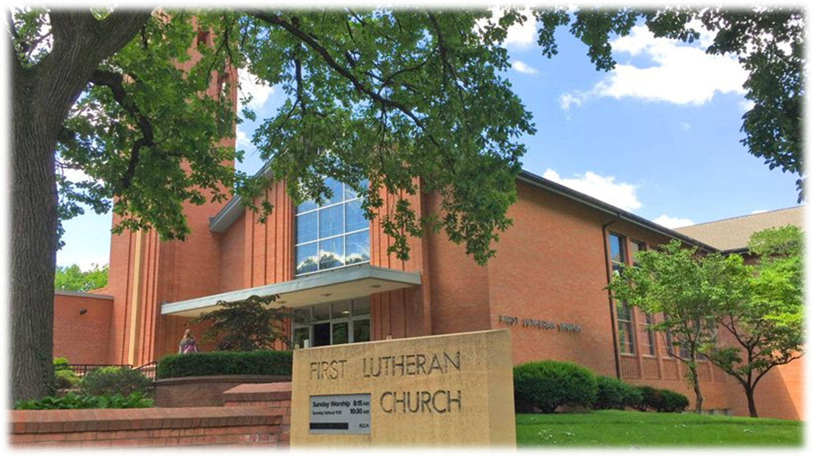
6400 State Line Rd
First Lutheran Church
Closed on the property in August 2025
Existing tenants leasing back the property for 18 months
City engaged SixTwentyOne to complete a Property Condition Assessment and Evaluate Scenarios/Costs
Spring 2026 - Town Hall meetings to review and explore options

Slide 21
World Cup 2026
City is working with local partners – Police, Fire, Johnson County Emergency, and neighboring cities to be prepared to welcome 650,000 guests to the metro
City Rental Program
  Rental Permit with the City is required for all rentals including World Cup
  Permits must be for 60 day minimum
  City-wide letter will further explain the process
  Call City Hall with questions

Slide 22
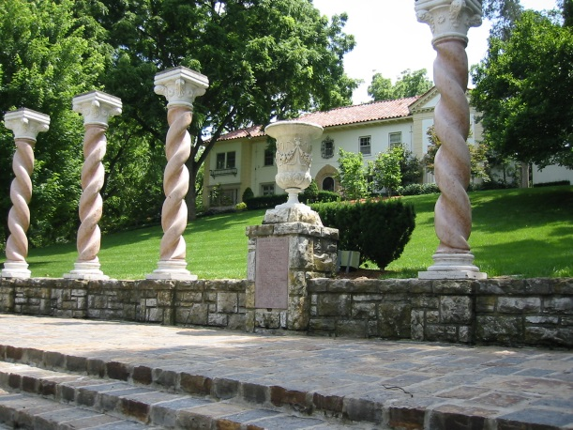
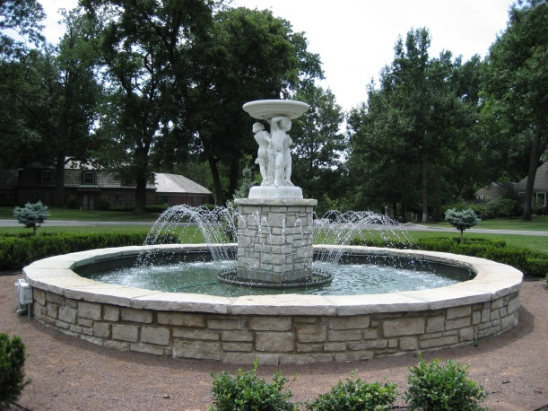
Conclusion: State of the City is Good
Strong financial position
The crime trend is down significantly.
Our volunteers are essential!
Fine tuning processes to encourage thoughtful redevelopment
Thank you!

